Slide 1
Mechanical Engineering Senior Design (ME490) Team MPM01-01-A, STORK Project 01, California Unmanned Aerial Systems Competition (C-UASC) Project Management Plan Presentation October 7th, 2024
Luis Laurean, Justin Ochoa, Nathan Lozano, Eddie Meza, Allan Valdez, Luiz Gonzalez Bautista, Daniel Solomon, Flavio Signoretti, Jalen Jones, Sophia Garcia

Slide 2
Agenda
Project Overview: Nathan Lozano
Team Organization Chart: Nathan Lozano
Work Breakdown Schedule: Allan Valdez
Schedule – IMS: Luis Laurean
Schedule – IMS (continued): Luis Laurean
Budget – Labor Budget: Justin Ochoa
Budget – Material Budget: Justin Ochoa
Risk Management – Project Risk List: Eddie Meza
Risk Management – Project Risk Cube: Eddie Meza
Summary / Key Points – Allan Valdez

Slide 3
Project Overview
The C-UASC is a student competition organized by California State University and by Mojave Air & Space Port at Rutan Field. The competition requires students to design, integrate, and demonstrate a small Uncrewed Aerial System (sUAS) capable of waypoint navigation, package drop, package delivery, and target identification and localization.
Need: To stimulate interest in Unmanned Aerial Systems and to engage students in a challenging mission.
Sponsor: Oscar Correa, Student Success Fee, ocorrea6497@sdsu.edu

Slide 4
Team Organization Chart
Mechanical Engineering
Electrical and Computer Engineering
Luis Laurean
Team Leader
Luiz Bautista
Team Leader
Justin Ochoa
Procurement Specialist
Nathan Lozano
Jalen Jones
Sophia Garcia
Eddie Meza
Allan Valdez
Daniel Solomon
Flavio Signoretti

Slide 5
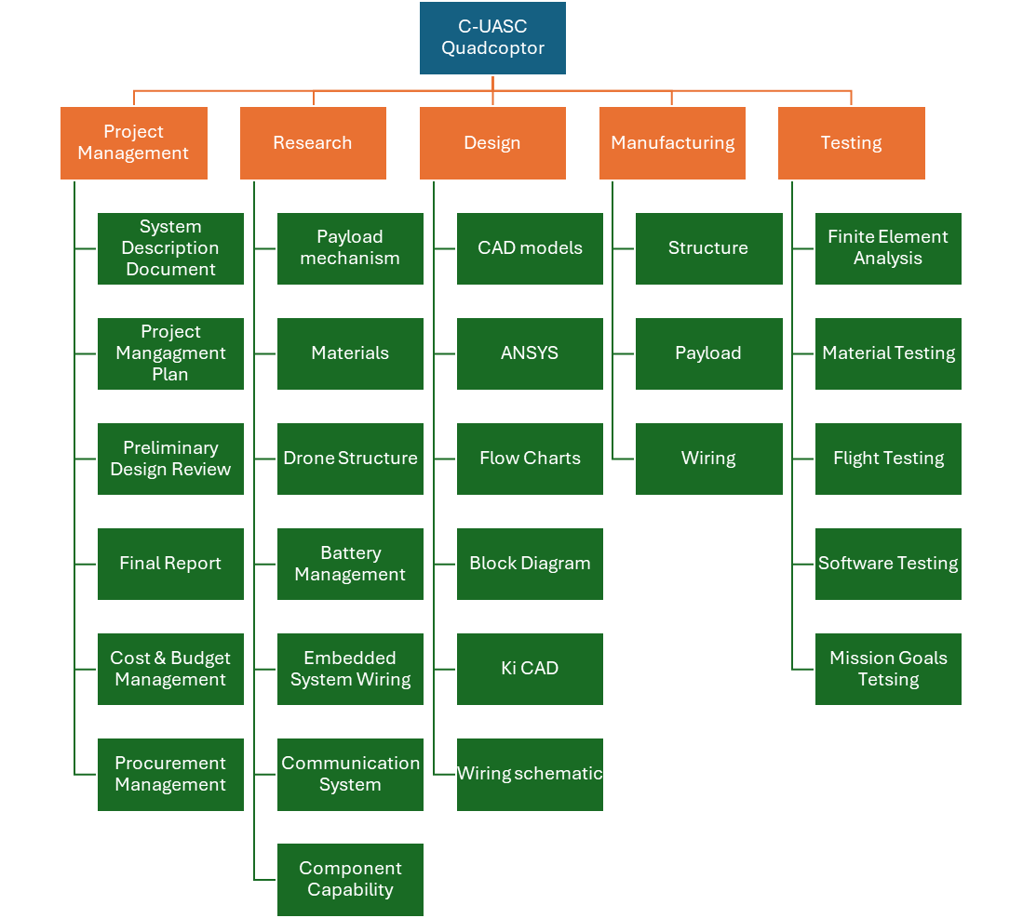
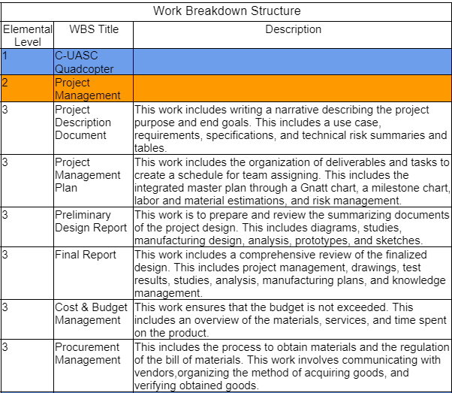
WBS

Slide 6
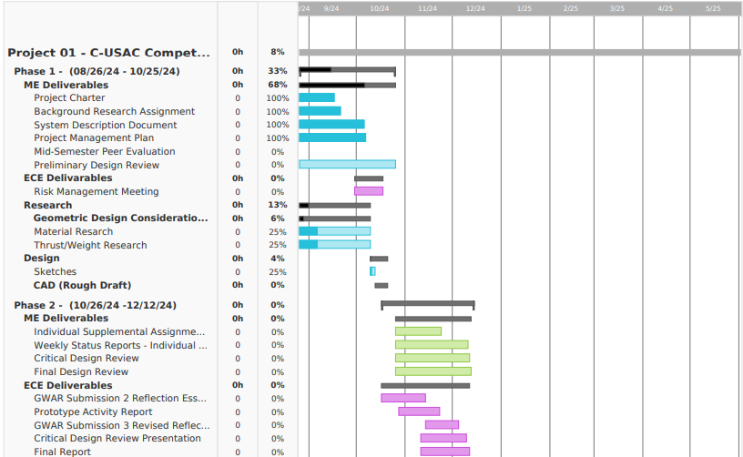
Schedule – IMS (Gantt Chart)

Slide 7
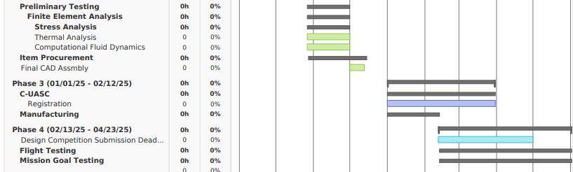
Schedule – IMS (Gantt Chart) cont.

Slide 8
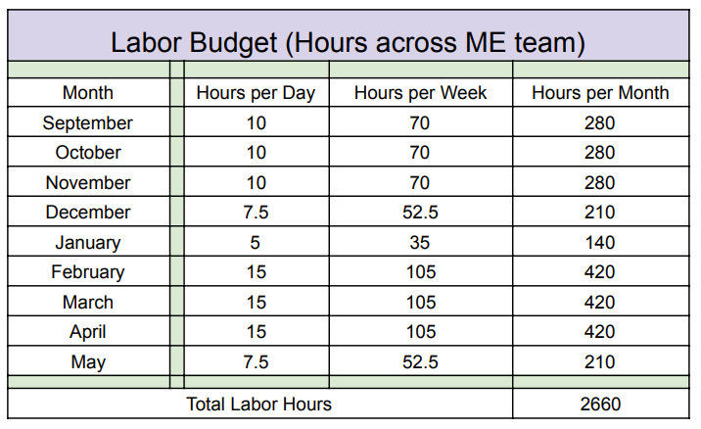
Budget – Labor Budget (hours) estimate (by Month)

Slide 9
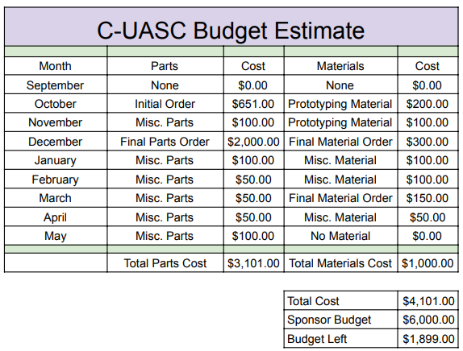
Budget – Material Budget (dollars) estimate (by Month)

Slide 10
Risk Management – Project Risk List
# | Risk Statement | Level of Consequence
1 | If the battery overheats then it may cause damage to components and potentially catch on fire. Will need to order new components and rebuild the drone. It will impact the budget and the timeline. | 5
2 | Signal interference may cause GCS to lose contact with the drone and that may cause the drone to act unpredictably and may cause property damage or injuries. The team will fail to accomplish all objectives. | 5
3 | The camera does not provide a clear picture and thus not finding the waypoints. This will waste a lot of time during the competition | 2
4 | Drone crashes due to improper balancing or high winds. Will need to order parts and rebuild the drone causing significant schedule slips and money spent. | 5
5. | The latching mechanism fractures releasing the payload prematurely. The team will need to rebuild the latching mechanism which will set the team behind schedule. Additional funds will be placed on the repair process. | 4
6. | If a PCB short circuits, the drone will not be able to run. Will need to order new boards and the connections will need to be soldered again. This will impact the timeline significantly. | 4
7. | If the structure of the drone is too difficult to manufacture or the team lacks the skills, then the parts would be outsourced, taking away from the budget and thus the team's progress will temporarily be halted. | 3
Level of Likelihood | Risk Mitigation Method | Risk Eval.
2 | Have a battery management system (BMS) to monitor battery temp etc.
5 | Invest in a robust communication system. Will use a directional antenna as opposed to an omnidirectional antenna that was used last year. Competition organizers will conduct an EM survey.
4 | Invest in a higher-quality camera. Do a trial run in an environment where the ground will produce a reflective glare onto the camera lens. Try out multiple cameras to see which one produces less glare.
2 | Proper weight calibration is in mind when designing the drone. The symmetrical design will mitigate improper balancing.
2 | Finite element analysis either through SolidWorks or Ansys will demonstrate the maximum load the latching mechanisms can carry without yielding or fracturing. Have the latching mechanism be a separate piece from the drone, so that if fracture or yielding occurs, replacing the piece should be a lot quicker, so no schedule slip.
4 | Have extra PCBs with the connections already soldered on. Easily swap out defective boards with the backup.
3 | The more complicated structures would get worked on as soon as possible. Significant time can be spent on manufacturing during winter break.

Slide 11
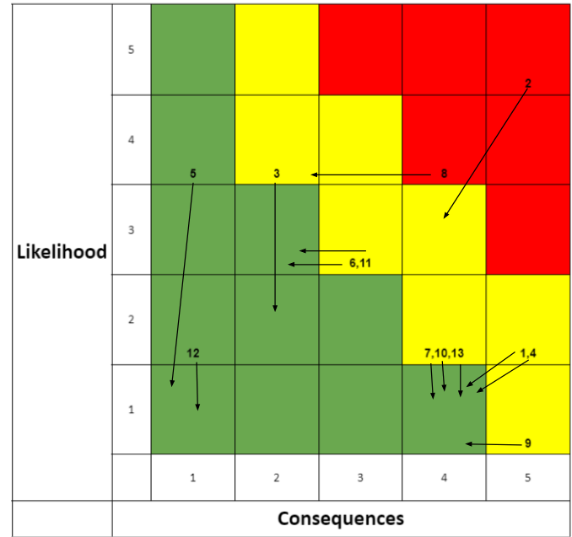
Risk Management – Project Risk Cube

Slide 12

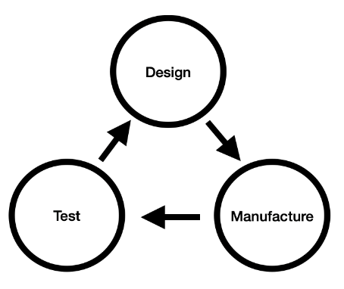

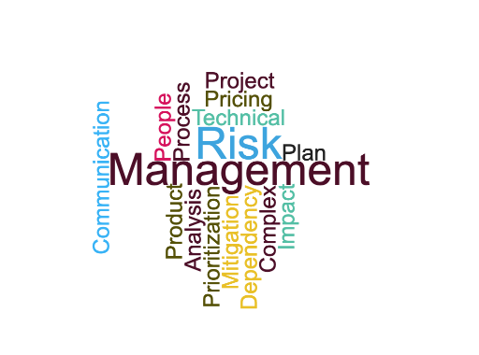
Summary / Key Points
The C-UASC competition will require a sUAS capable of waypoint navigation, package delivery, and target identification. This project is sponsored by the Student Success Fee Program with Oscar Correa as a representative.
The project requires the cooperation of both mechanical, electrical, and computer engineers who will all be responsible for project and system requirements.
The project is laid out into four phases: research/design, procurement/material selection, manufacturing/assembly, and flight testing. A combined estimated total of 2,660 labor hours and an estimated budget of around $4,000 will be spent.
Finally, an accumulation of risks involving personnel, logistics, and manufacturing were taken into consideration and assessed for mitigation.

